Slide 1
MIPS Tutorial 2
Function / Stack / Recursion

Slide 2
Function Calls
When function completes, it returns back to the next instruction of its caller function
Data are passed as arguments from caller to callee, results are returned to the caller
Function_call ()
Function()

Slide 3
Function Call and Return Instructions
Use JAL, JR instruction and $ra register
jal <lable>
  Save current pc+4 in $ra register (return address)
  Jump to <lable>
jr $ra
  Jumps back to the caller (pc ← $ra)

Slide 4
Example of a Function Call
main:
………………
jal function
………………
j end
function:
  li $v0, 4
  la $a0, string1
  syscall
  jr $ra
…
Caller
$ra store the address
Callee
Function_call ()
Function()

Slide 5
Arguments and Return Values
Register
  Faster and easy to code
  $a0 - $a3 are used for arguments passing from caller to callee
  $v0 - $v1 are used for returning value from callee to caller
What if we have more than 4 arguments?

Slide 6
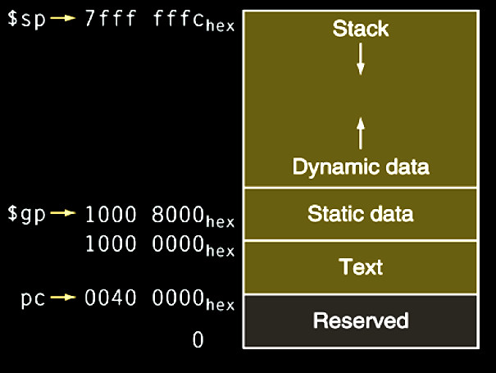
Stack
Last In First Out
  Push to/pop from the top of the stack
Stack pointer is pointed at the top of stack
Highest address
SP
Lowest address

Slide 7
Push/Pop Single Element
Push and Pop $s0 to the stack
Push:
  addi $sp, $sp, -4
  sw $s0, 0($sp)
Pop:
  lw $s0, 0($sp)
  addi $sp, $sp, 4
SP
s0
s0

Slide 8
Push/Pop Multiple Elements
Push/Pop $s0, $s1, $s2 to the stack
Push:
  addi $sp, $sp, -4
  sw $s0, 0($sp)
  addi $sp, $sp, -4
  sw $s1, 0($sp)
  addi $sp, $sp, -4
  sw $s2, 0($sp)
Push:
  addi $sp, $sp, -12
  sw $s0, 8($sp)
  sw $s1, 4($sp)
  sw $s2, 0($sp)
Pop:
lw $s2, 0($sp)
addi $sp, $sp, 4
lw $s1, 0($sp)
addi $sp, $sp, 4
lw $s0, 0($sp)
addi $sp, $sp, 4
Pop:
lw $s2, 0($sp)
lw $s1, 4($sp)
lw $s0, 8($sp)
addi $sp, $sp, 12

Slide 9
Arguments and Return Values
Use the stack
  Slower and more codes
  Arguments/return values are pushed into the stack and then popped from callee/caller

Slide 10
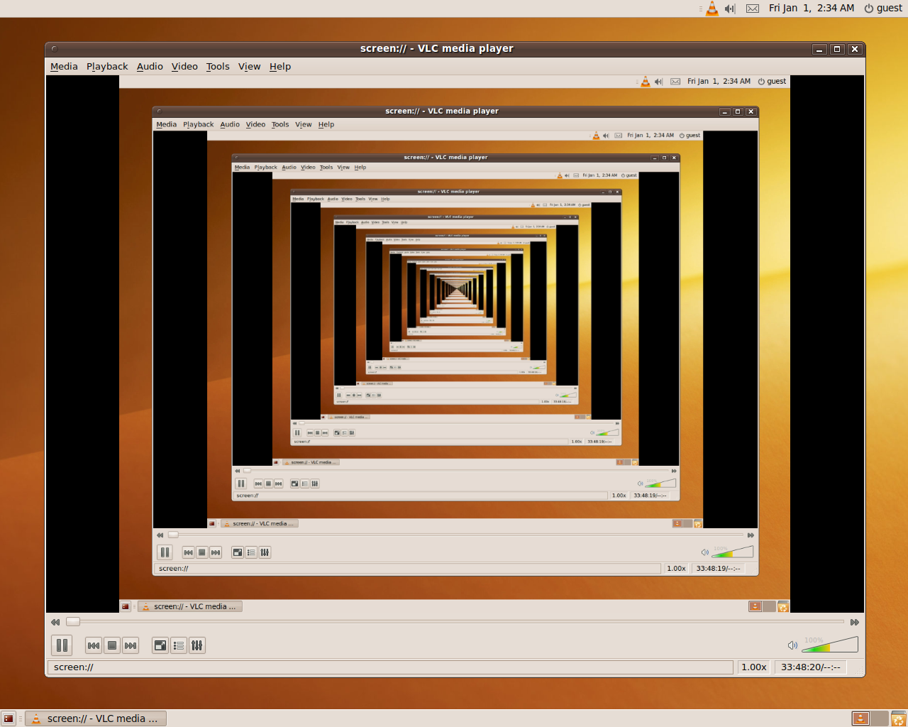
Recursive Call
Function calling itself
  Reduce subproblem size (divide-and-conquer)
  Termination condition
Examples
  Factorial
  Fibonacci

Slide 11
Factorial Example
Need to carefully preserve $sp, $ra
Calculate 2!
int fact(int n)
{
if (n < 1)
return (1);
else
return (n * fact(n - 1));
}
2 * fact(1)
1 * fact(0)
# Termination condition
1

Slide 12
fact:
addi $sp, $sp, -8 # adjust stack for 2 items
sw $ra, 4($sp) # save return address
sw $a0, 0($sp) # save argument
slti $t0, $a0, 1 # test for n < 1
beq $t0, $zero, L1
addi $v0, $zero, 1 # if so, result is 1
addi $sp, $sp, 8 # pop 2 items from stack
jr $ra # and return
L1:
addi $a0, $a0, -1 # else decrement n
jal fact # recursive call
lw $a0, 0($sp) # restore original n
lw $ra, 4($sp) # and return address
addi $sp, $sp, 8 # pop 2 items from stack
mul $v0, $a0, $v0 # multiply to get result
jr $ra # and return
Main
Main
2
1
Termination condition
0
Stack
Main’s address
$v0 = 2*$v0
2
$v0 = 2
2’s address
$v0 = 1*$v0
1
$v0 = 1
1’s address
$v0 = 1
0

Slide 13
fact:
addi $sp, $sp, -8 # adjust stack for 2 items
sw $ra, 4($sp) # save return address
sw $a0, 0($sp) # save argument
slti $t0, $a0, 1 # test for n < 1
beq $t0, $zero, L1
addi $v0, $zero, 1 # if so, result is 1
addi $sp, $sp, 8 # pop 2 items from stack
jr $ra # and return
L1:
addi $a0, $a0, -1 # else decrement n
jal fact # recursive call
lw $a0, 0($sp) # restore original n
lw $ra, 4($sp) # and return address
addi $sp, $sp, 8 # pop 2 items from stack
mul $v0, $a0, $v0 # multiply to get result
jr $ra # and return
Termination condition
0X7fffeffc
0X00400020
2
0X7fffeff4
0X00400080
1
0X7fffefec
0X00400080
0
0X7fffefe4

